Slide 1



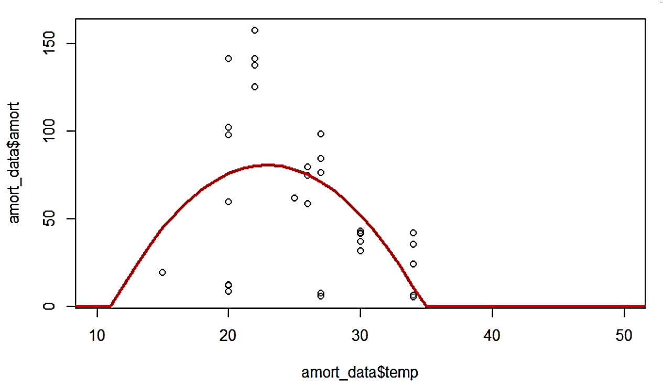
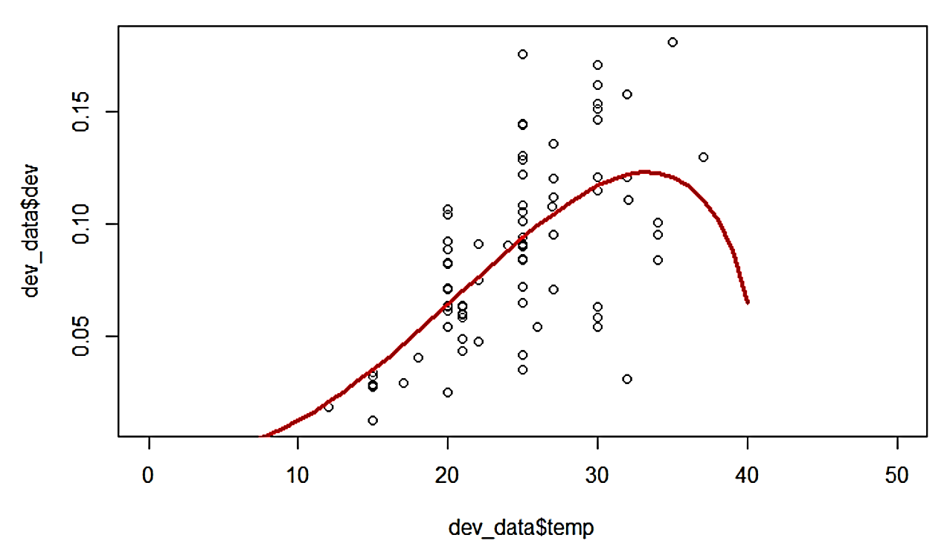
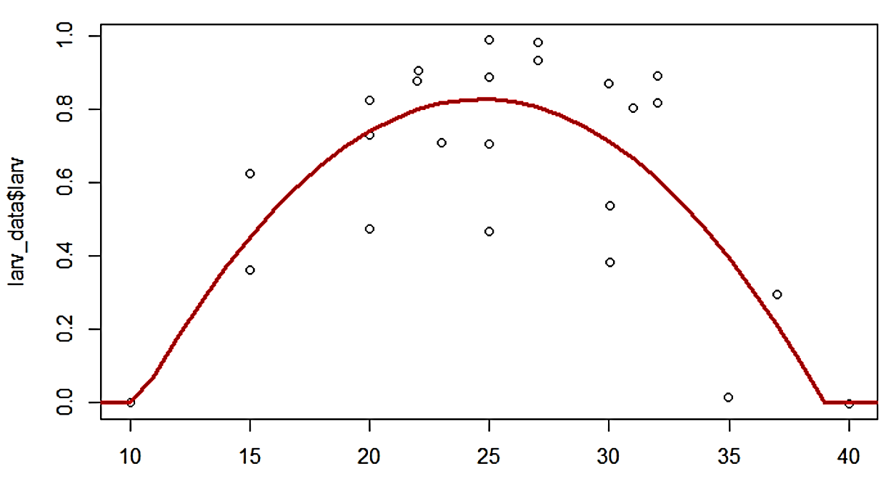
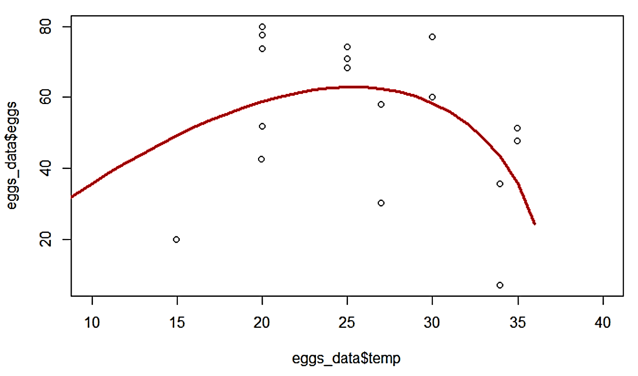
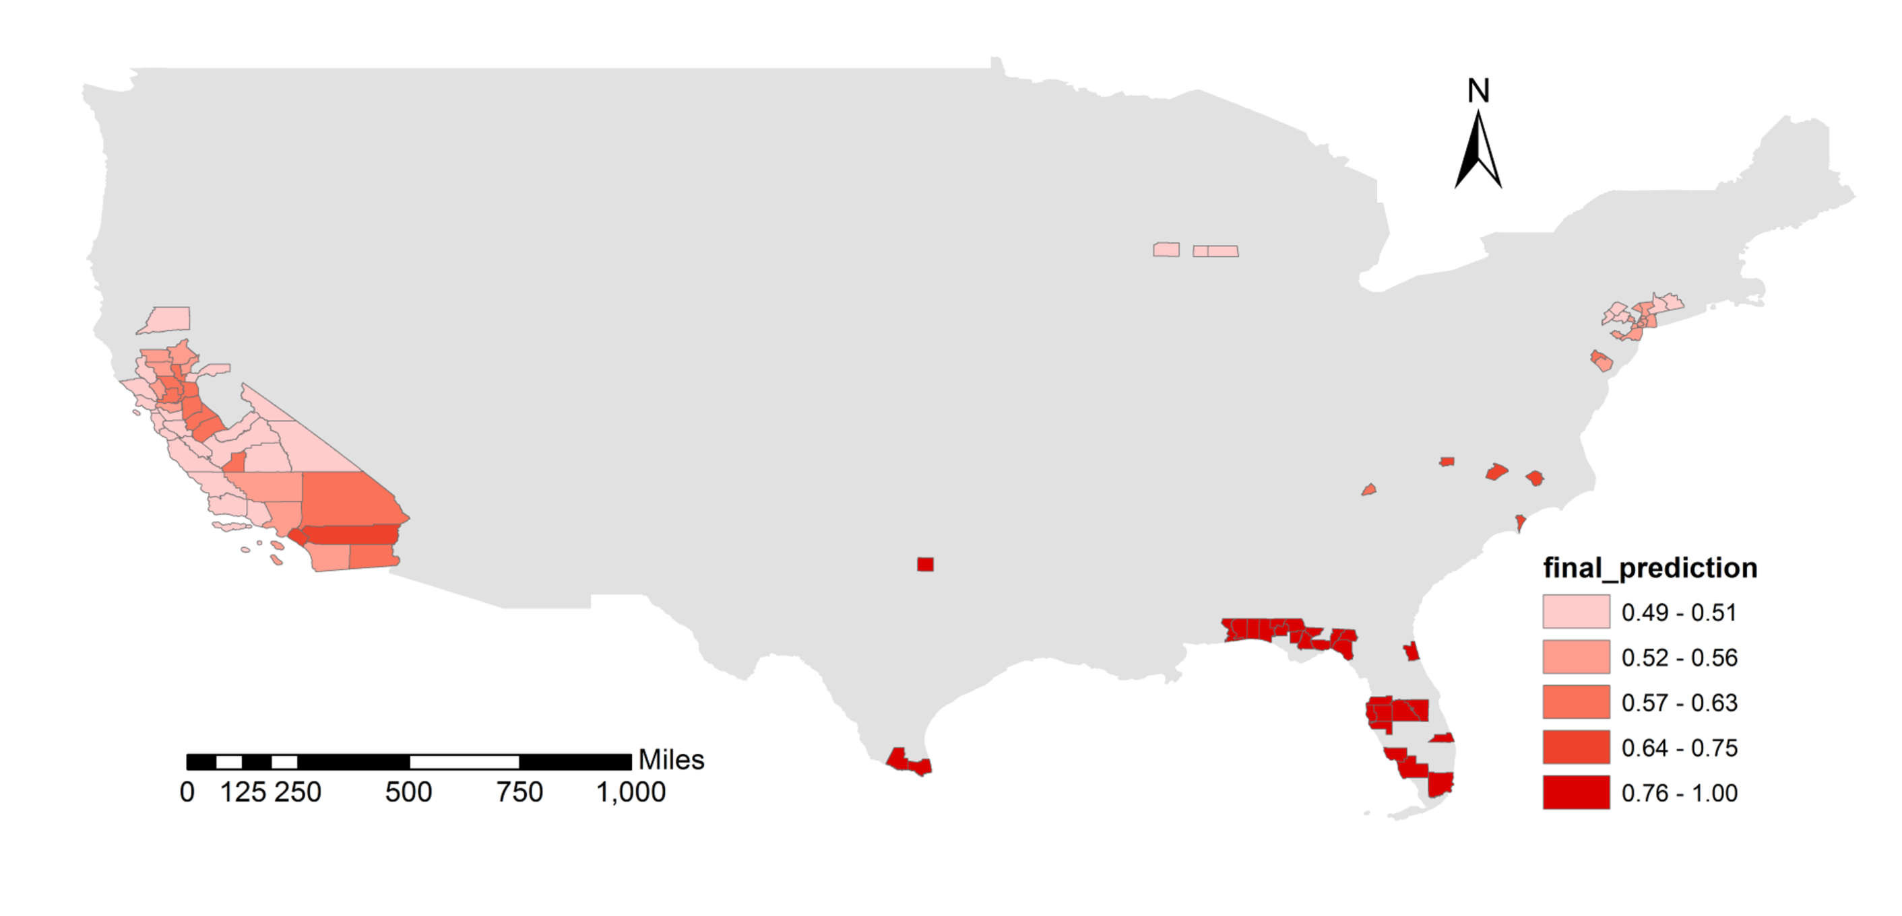
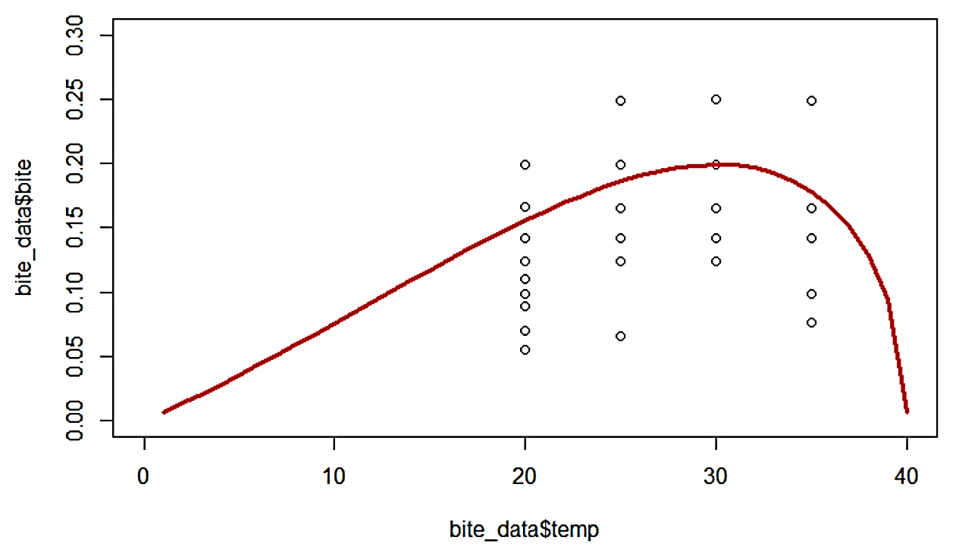
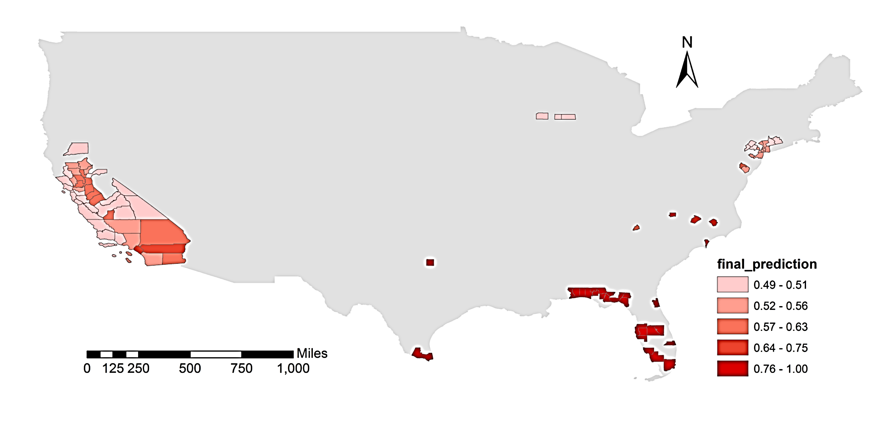
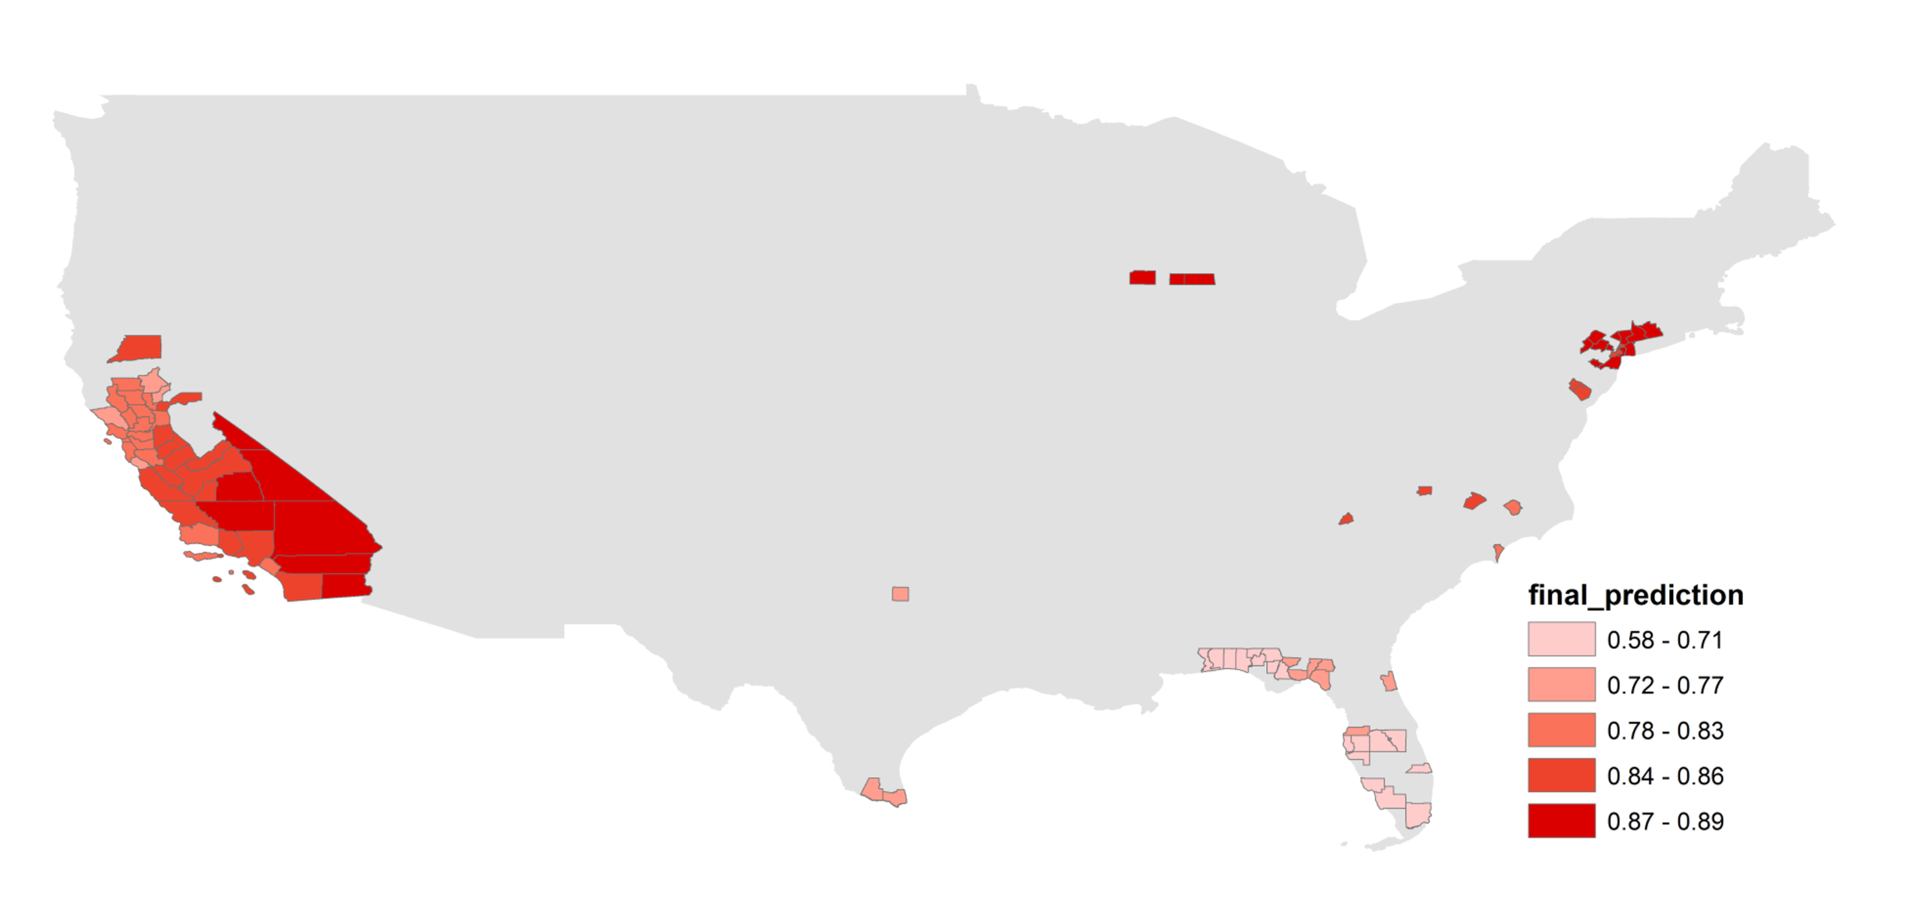
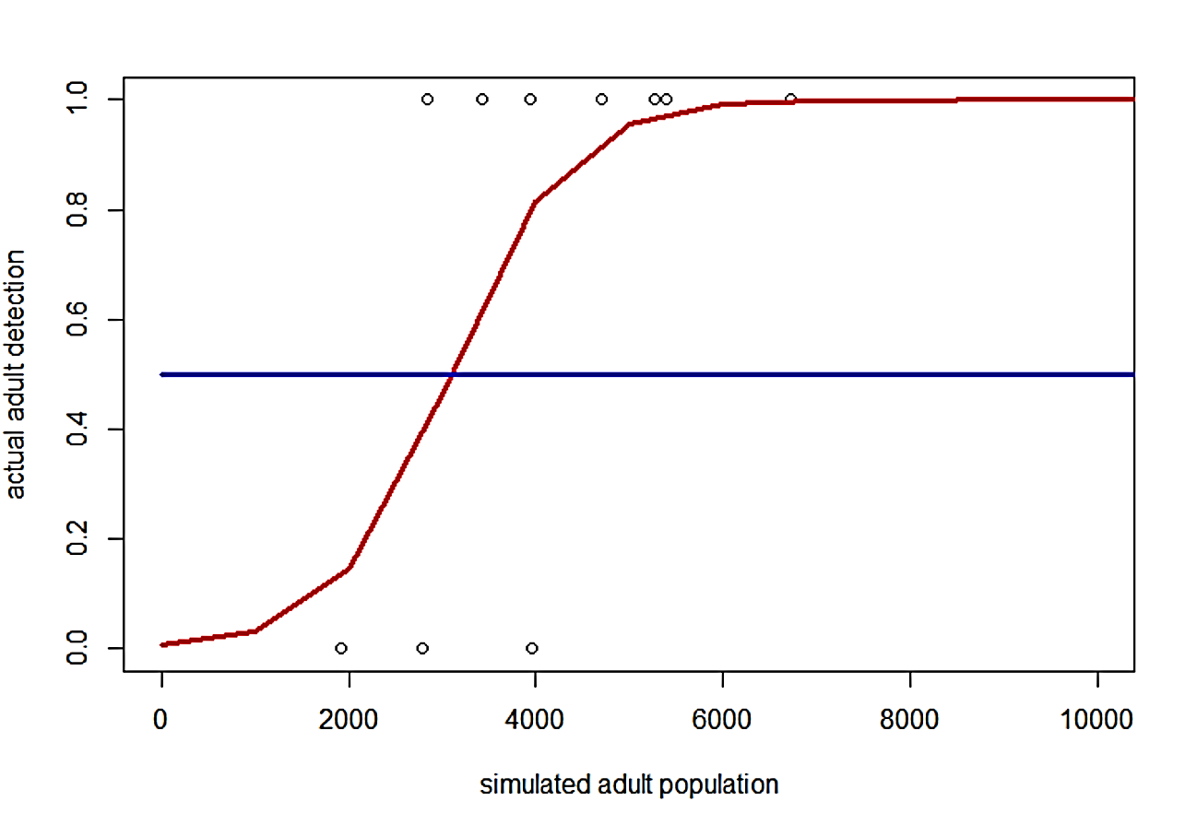
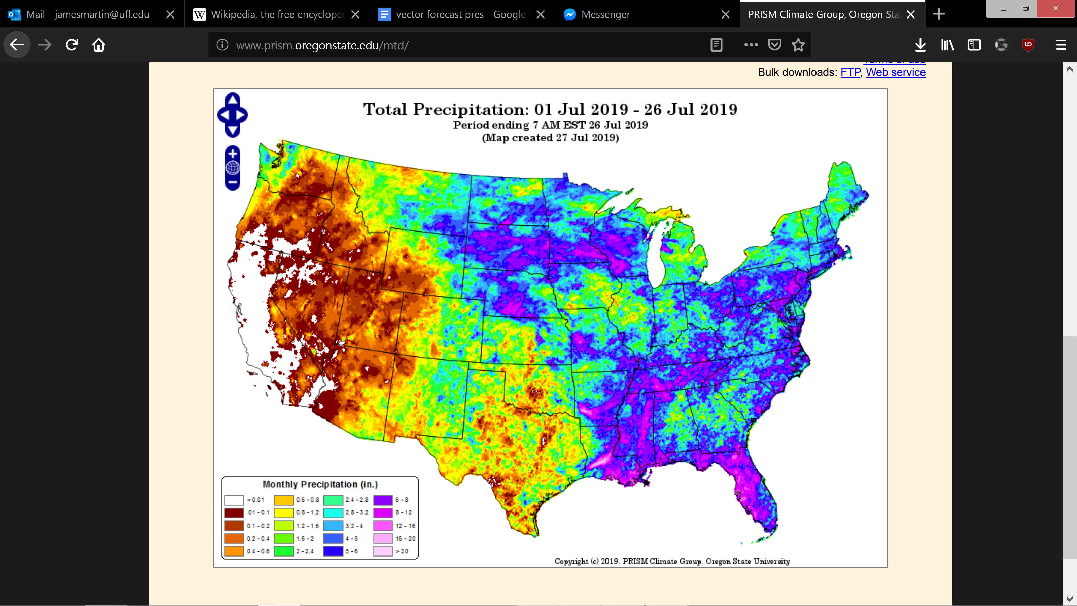
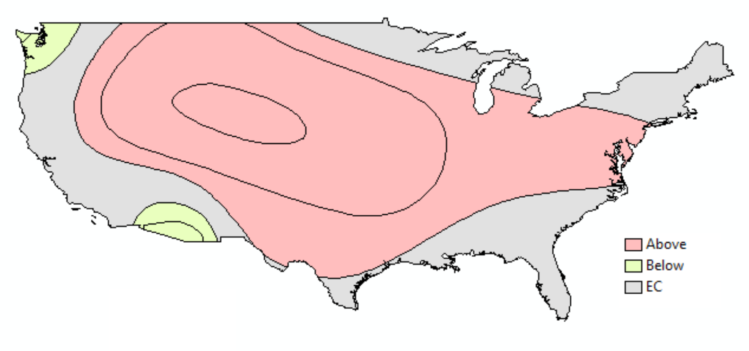
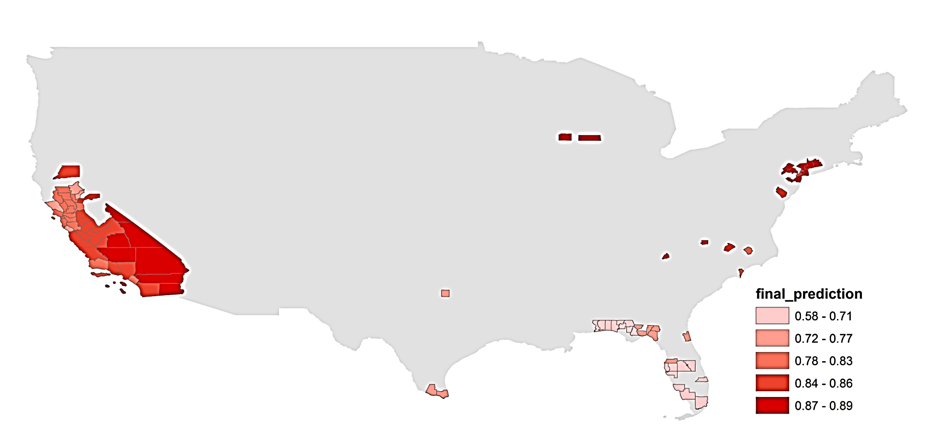

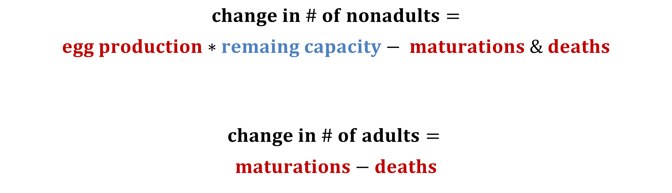
UF MathGeo Model: A Mechanistic Approach Using Vector Traits and Georeferenced Climate Data
James L. Martin^{1,2*}, Maia Martcheva³, Sadie J. Ryan^{1,2} ¹Quantitative Disease Ecology & Conservation Lab, Department of Geography, University of Florida, Gainesville, FL, USA;
²Emerging Pathogens Institute, University of Florida Gainesville, FL, USA;
³Department of Mathematics, University of Florida Gainesville, FL, USA
*Contact: jamesmartin@ufl.edu,
Process: Our forecasts are generated in two steps. In step 1 the historical population of both species are simulated in each county using climate data from 2007 to 2018. The simulated number of adults in each county is compared to the collections made each month. In step 2 we generate forecasts by picking up where step 1 left off. The model is used to simulate vector populations in 2019 and each month new climate forecasts are used to estimate population growth and decline the next month. Population counts are then converted to probability of presence using the detection curve made in step 1.
Traits: Most parameters in our model are biological functions which dependent on temperature. The response of these functions are non-linear, meaning there’s an optimum temperature for performance. To inform these parameters we used compiled data¹ from laboratory studies on traits of both species where mosquitos were kept in different temperature treatments.
$$change in \# of nonadults=$$
$$egg production∗remaing capacity− maturations \& deaths$$
$$change in \# of adults=$$
$$maturations−deaths$$
Adult Lifespan
Development rate
Days
Per day
Extract Climate data
Model 2007 to 2018
Fit Detection Curve
Step 1
$$Temperature dependent$$
Survival to adulthood
Fecundity
Fit Curves to Traits
$$Precipitation dependent$$
Probability
Eggs
Daily Data to Month
Extract Climate data
Model 2019
Estimate Presence
Step 2
Aedes aegypti
Biting Rate
Convert Forecast Data
Per day
Probability of
Detection
Detection: Our model does not directly predict the probability of vector presence. It provides a simulated population which must be converted to presence. To do this we fit a logarithmic function to the simulated vector population generated in step 1 and the collection data spanning 2007 to 2018 provided by the CDC. We then use this curve to convert the model output each month of 2019 into the probability of presence.
Climate: The driving factors of vector populations at the macro scale are temperature and precipitation. To inform our climate dependent model we use data from two sources. For the past we use the PRISM dataset compiled at Oregon State University. This dataset uses a linear model to create gridded climate data from ground stations and is available at 4km² resolution. For prospective climate conditions we use NOAA’s monthly climate outlooks which forecasts the deviation of climate conditions from their historical ranges. This format requires conversion to be used in our model.
Aedes albopictus
Probability of
Detection
Actual Adult Detection
June
NOAA
Simulated Adult Population
PRISM (OSU)
Mordecai EA, Cohen JM, Evans MV, Gudapati P, Johnson LR, Lippi CA, Miazgowicz K, Murdock CC, Rohr JR, Ryan SJ, Savage V. Detecting the impact of temperature on transmission of Zika, dengue, and chikungunya using mechanistic models. PLoS neglected tropical diseases. 2017 Apr 27;11(4):e0005568.

